Slide 1
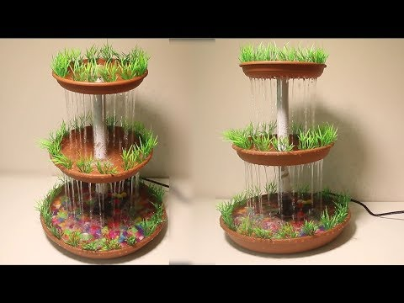
SMART WATER FOUNTAIN
BY….,
SHAMEENA.W

Slide 2
INTRODUCTION
Our goal is to design a smart water fountain that can monitor the water quality and automatically replace water when polluted or running out.
We will use sensors to measure the water quality.Common water quality measurement factors include temperature, Ph-value,conductance, turbidity and hardness.
The water fountain is also designed to self-filter the water every time when water is pumped through the submersible water pump

Slide 3
PROBLEM STATEMENT :
When the water flow does not have any restrict , there is lose of water in household as well as environment .
The lack of fountains in a community can have a number of negative consequences for people, the environment, and the local economy.

Slide 4
Project statement
HARDWARE
First we start by using the Wio Node and a relay ,also going to a screen for feedback and text.Using the relay we can control the power supply.
SOFTWARE
The hardware is all connected ,its time to setup the software . We will use the Wio app by seeed.

Slide 5
COMPONENTS
Relay - 4
Temperature sensor - 1
Relay driver- 1
IoT ESP8266Wifi module.
Power supply

Slide 6
design
STEP 1: Install Android/iOS App
STEP 2: Create your Account
STEP 3: Connect Wio Node to Internet
STEP 4: Virtually interconnect modules with Wio Node and update firmware
Here is where we add the 2 components
Relay
OLED

Slide 7
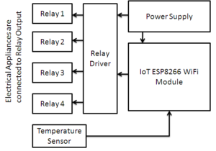
Block diagram

Slide 8
Code for the proposed projet:
def activate_fountains(fountains):
n = len(fountains)
min_fountains = float('inf’)
for i in range(1, 2**n):
activated = []
for j in range(n):
if (i >> j) & 1:
activated.append(j)
if is_covered(activated, fountains): min_fountains = min(min_fountains,len(activated))
return min_fountains

Slide 9
def is_covered(activated, fountains):
n = len(fountains)
coverage = [0] * n
for i in activated:
left = max(0, i - fountains[i])
right = min(n - 1, i + fountains[i])
for j in range(left, right + 1):
coverage[j] = 1
return all(coverage)
a1 = [1, 2, 1]
a2 = [2, 1, 1, 2, 1]
print(activate_fountains(a1)) print(activate_fountains(a2))

Slide 10
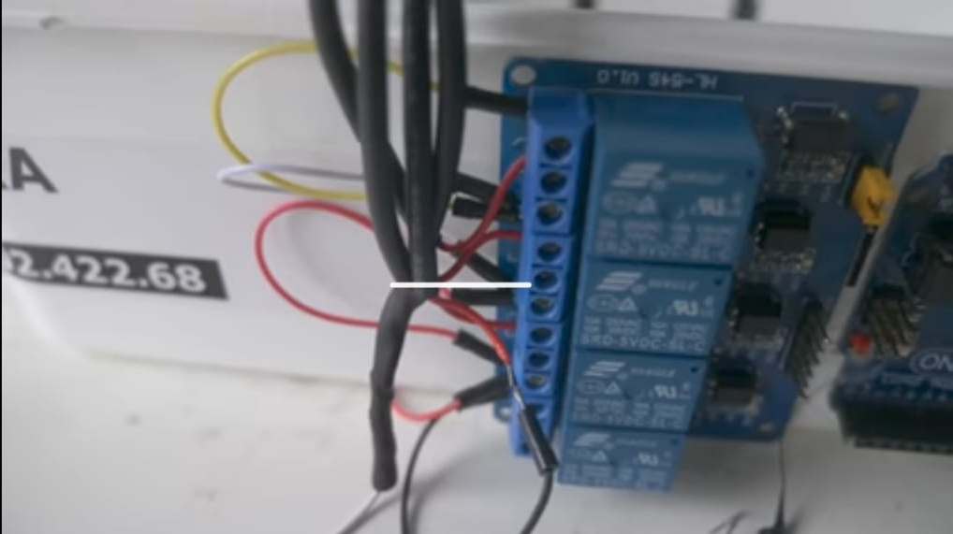
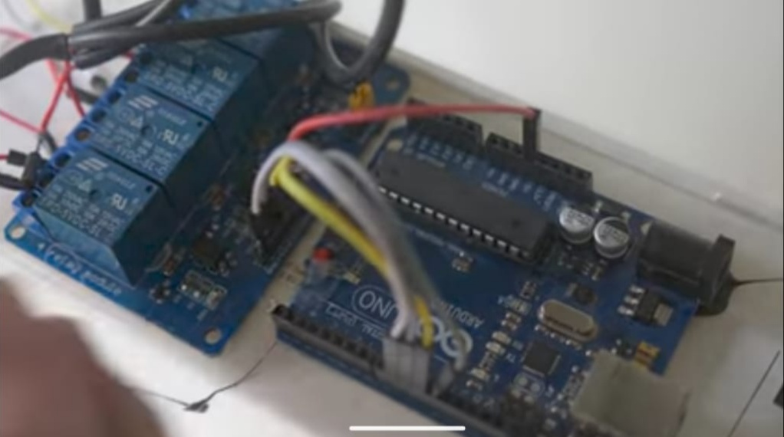
Simulation input

Slide 11
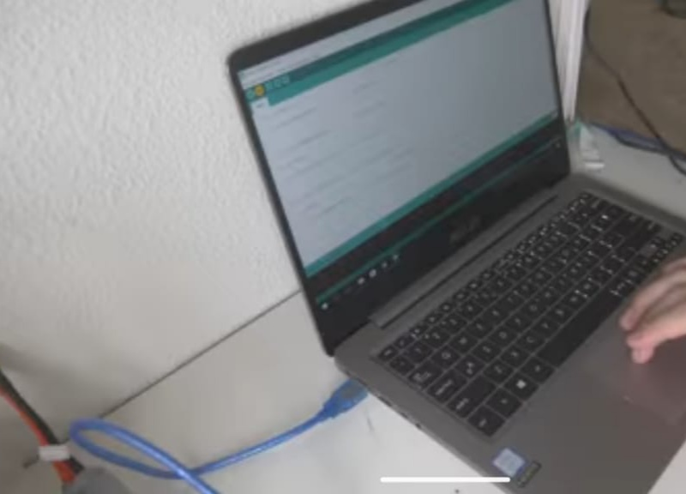
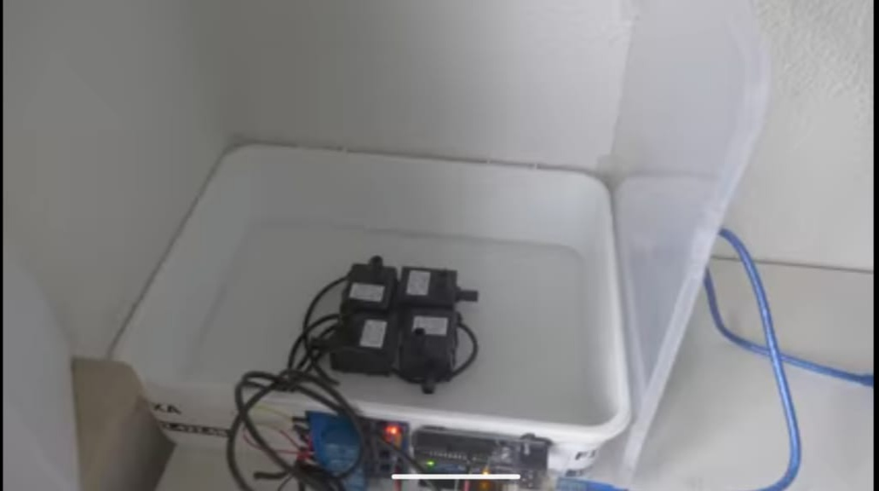
Simulation process

Slide 12
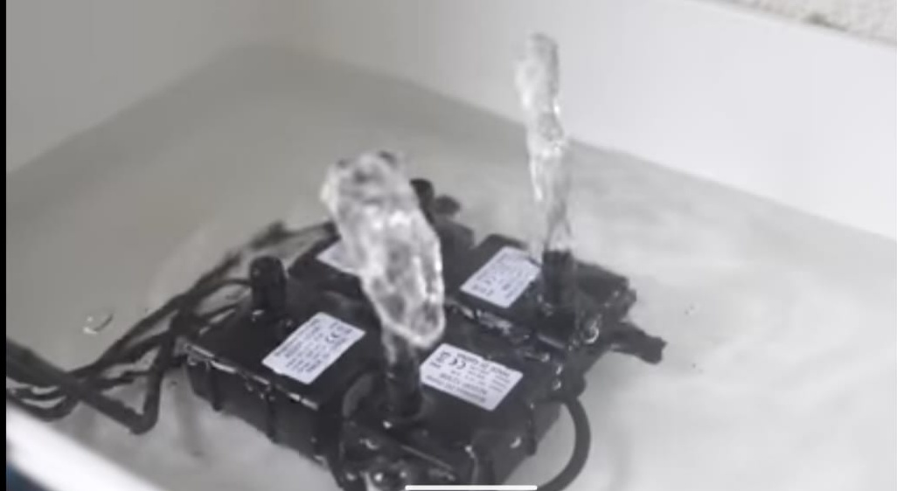
Simulation output

Slide 13
SIMULATION INPUT: The input connection are made from relay to arudino as per the software simulation arrangements.
SIMULATION PROCESS: The inputs get performed based on the simulation program.
SIMULATION OUTPUT: When the program runs the water from the waterpumper comes out at particularly time duration.

Slide 14


